Slide 1
Building Microsoft Graph Applications
Build a .NET console application using Microsoft Graph

Slide 2
Build a JavaScript application using Microsoft Graph
Application registration
Obtaining Packages
Application experience
Overview of the sample

Slide 3
Build a JavaScript application using Microsoft Graph

Slide 4
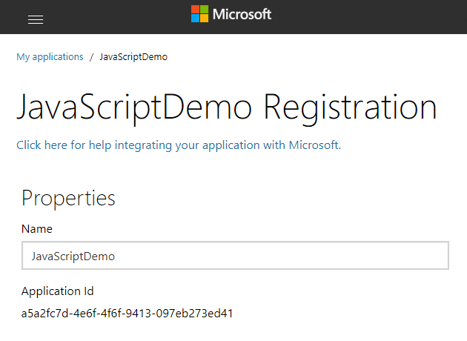
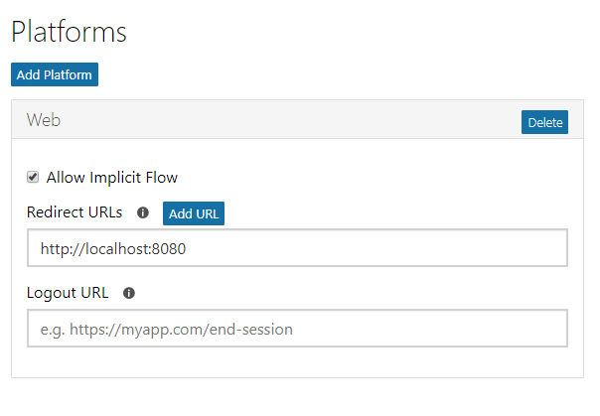
Application registration
Create a new application
Create a new application in the Application Registration Portal. A unique identifier is created for your app.
Add a Web platform
Add a Web platform to your application registration. Enable the “Allow Implicit Flow” checkbox, and provide the redirect URL.

Slide 5
MSAL Package Installation
NPM:
npm install msal
CDN:
https://secure.aadcdn.microsoftonline-p.com/lib/0.1.1/js/msal.min.js
Notes:
See https://github.com/AzureAD/microsoft-authentication-library-for-js for more information.
Note that msal.js is built for ES5, therefore enabling support of Internet Explorer 11. If you want to target Internet Explorer, you'll need to add a reference to promises polyfill. You might want to read more in the FAQ
<!-- IE support: add promises polyfill before msal.js --> <script src="https://cdnjs.cloudflare.com/ajax/libs/bluebird/3.3.4/bluebird.min.js" class="pre"></script> <script src="https://secure.aadcdn.microsoftonline-p.com/lib/0.1.1/js/msal.min.js"></script>

Slide 6
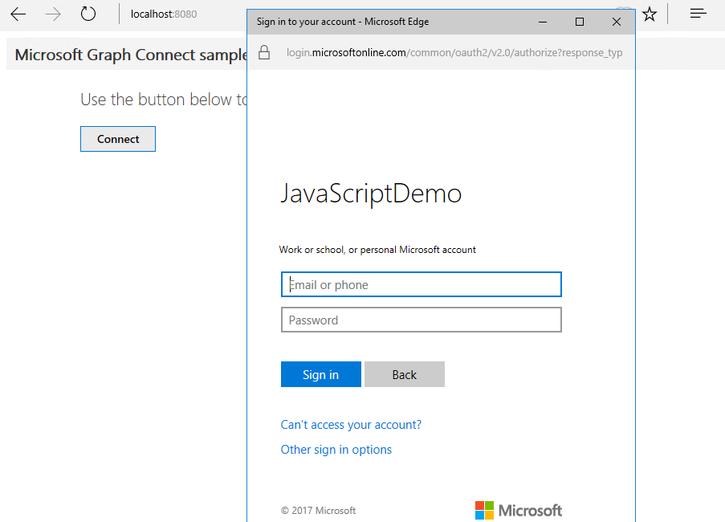
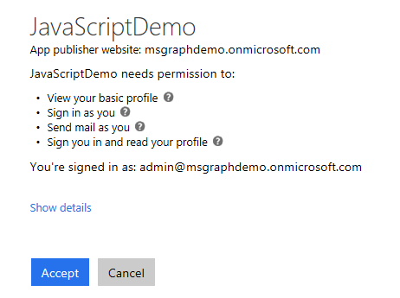
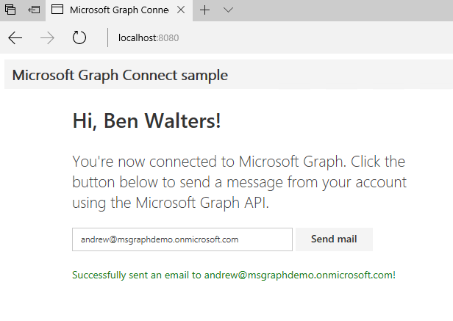
Application experience
User prompted to sign in
Navigate to http://localhost:8080 and click Connect, you are prompted to sign in.
Prompt for consent
The user is prompted to grant consent to the application.
Data is securely returned
The Microsoft Graph API is queried and data is securely returned to the client. Clicking the button, an email is sent to the email address provided.

Slide 7

Overview of the sample
Sign in, get token
Access token
Groups
Tasks
Teams
Calendar
Files
Get my profile
Chats
My profile
Microsoft Graph
Insights
Messages
Send email
Coworkers
User
Meetings
Devices
People

Slide 8
JavaScript applications – implicit grant and v2 endpoint
https://login.microsoftonline.com/common
Application
/common/OAuth/v2.0/authorize
https://graph.microsoft.com
?response_type=token&client_id=…
Sign in, consent
access_token
/v1.0/me (access token)
Current user’s profile
POST /v1.0/me/sendMail (access token)
HTTP 202
Notes:
JavaScript applications using the v2 endpoint work similarly to other types of applications, but use a flow type called “implicit flow”.
The call to /common/OAuth/v2.0/authorize will pop up a login screen and request permissions consent.
The access token is returned as part of the HTTP response.
The MSAL library handles the hidden sign-in request upon expiration, this is transparent to the user.

Slide 9
Demo

Slide 10
Scenarios where this is useful
Create an app that will automatically send status emails on behalf of the current user.
Integrate communications and operations processes to avoid forgetting important emails.

